Slide 1

Model Behavior: Training a Machine Learning Network in Real-Time

Slide 2
Agenda
Supervised Machine Learning Classification
When to use it (Cases)
About R
Credit Card dataset
Neural Networks

Slide 3
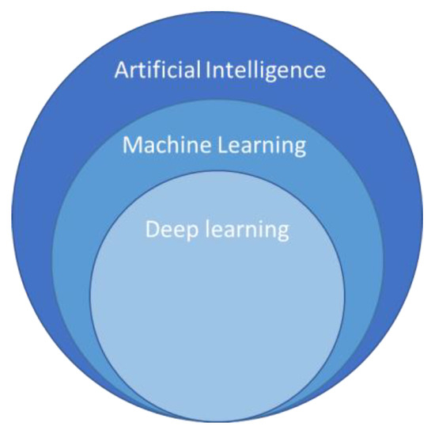
Machine Learning
Machine Learning
Unsupervised Learning
Supervised Learning
Clustering
Regression
Classification

Slide 4

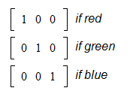
Supervised Learning
Machine Learning
Binary
Multinomial
Supervised Learning
Classification

Slide 5
When to use it (Cases)
Document classification
Spam filtering
Medical diagnostic test
Customer behavior prediction
Fraud detection

Slide 6

R and Data Science process
Collection
Cleaning
Exploring
Modeling
Deployment

Slide 7

Data Story - Credit Card Dataset

Slide 8
Supervised ML Model (Classification)

Slide 9

Supervised ML Model (Classification)
Cross Validation
Random Split:

Slide 10
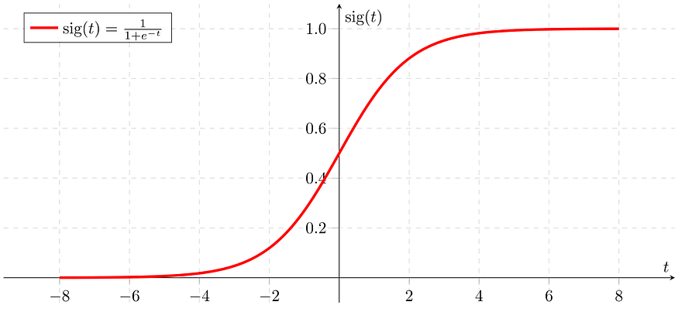
Classification model assumptions
There is minimal or no multicollinearity among the independent variables.
The observations to be independent of each other.

Slide 11
Model evaluation measures
Confusion Matrix- used to describe the performance of a classification model
Accuracy – simply measures how often the classifier correctly predicts
ROC AUC score shows how well the classifier distinguishes positive and negative classes. It can take values from 0 to 1

Slide 12

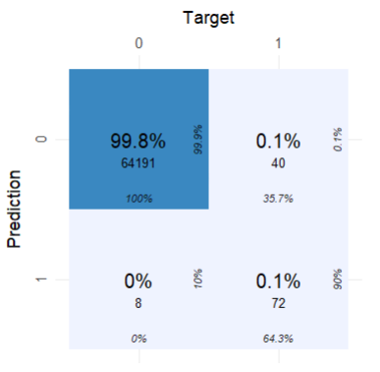
Supervised Classification model
Confusion Matrix
TP
FP
Evaluation | Scores
Accuracy | .9
Recall | .64
Precision | .9
ROC AUC | .96
F 1 score | .75
FN
TN

Slide 13
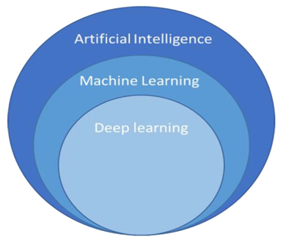


Slide 14
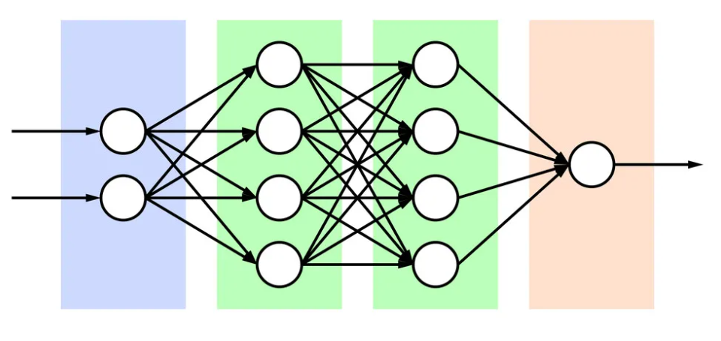
Neural Network
Hidden Layer(s)
Input Layer
Output Layer
neuron

Slide 15
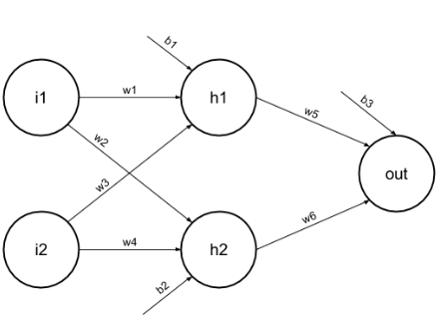
Neural Network
Basis
weights
activation function

Slide 16

Back to the Credit Card Dataset story Fraud detection

Slide 17

Using neuralnet package
library(neuralnet)
split <- createDataPartition(y = df$Class, p= 0.8, list = F)
creditcard.training <- df[split,]
creditcard.test <- df[ -split,]
creditcart.training.two <- creditcard.training%>% mutate_at(c(1:30), funs(c(scale(.))))
nn_model <- neuralnet(Class ~ ., data = creditcart.training.two, hidden = c(5,2), linear.output = F)

Slide 18
Using neuralnet package
library(neuralnet)
# plot our neural network
plot(nn_model, rep ="best")
#scale the test dataset
setcreditcart.test.two <- creditcard.test %>% mutate_at(c(1:30), funs(c(scale(.))))
#create the predicted values
predicted.nn.values <- neuralnet::compute(nn_model, creditcart.test.two)

Slide 19
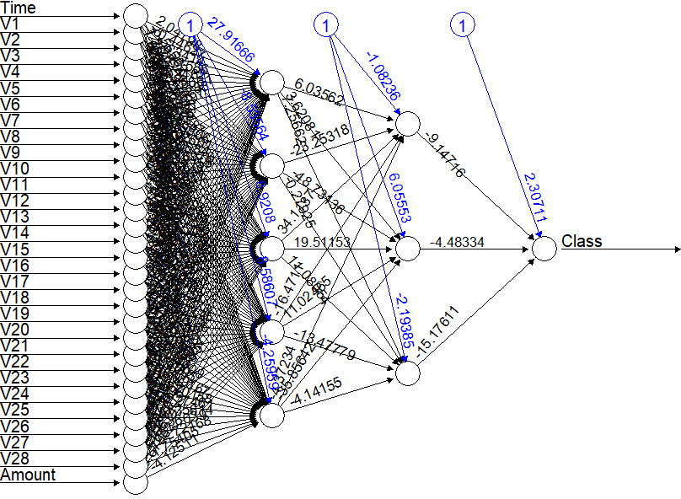

Slide 20

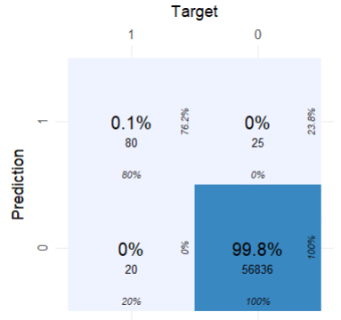
Deep learning (neural networks) model
Confusion Matrix
FN
TN
Evaluation | Scores
Accuracy | .99
Recall | .99
Precision | .99
ROC AUC | .89
F 1 score | .91
FP
TP

Slide 21

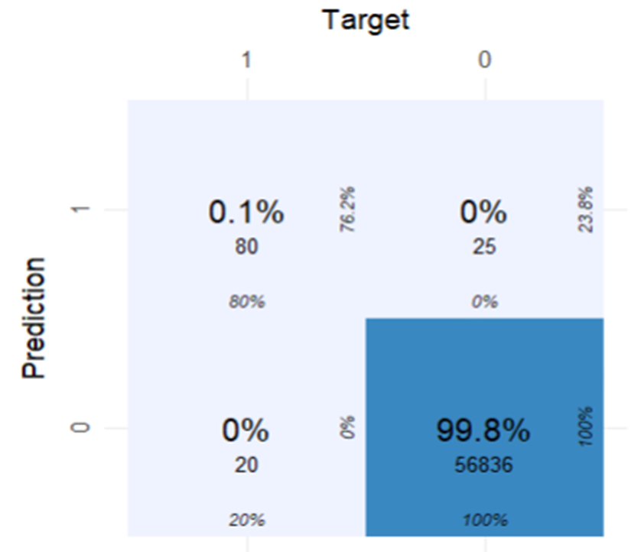
Confusion matrix
Supervised Classification model
Deep learning (neural networks) model

Slide 22
Model Evaluation Metrics
Supervised Classification model
Deep learning (neural networks) model
Evaluation | Scores
Accuracy | .90
Recall | .64
Precision | .90
ROC AUC | .96
F 1 score | .75
Evaluation | Scores
Accuracy | .99
Recall | .99
Precision | .99
ROC AUC | .89
F 1 score | .91

Slide 23

What did we learn?

